Slide 1
Movies and the Pandemic
Riley Capps
Erica Morales
Jose Davila
Mindy (Musch) Taylor

Slide 2
AGENDA
Riley’s Chart​s
Jose’s Charts
Erica’s Charts
Key Takeaways
​​​

Slide 3
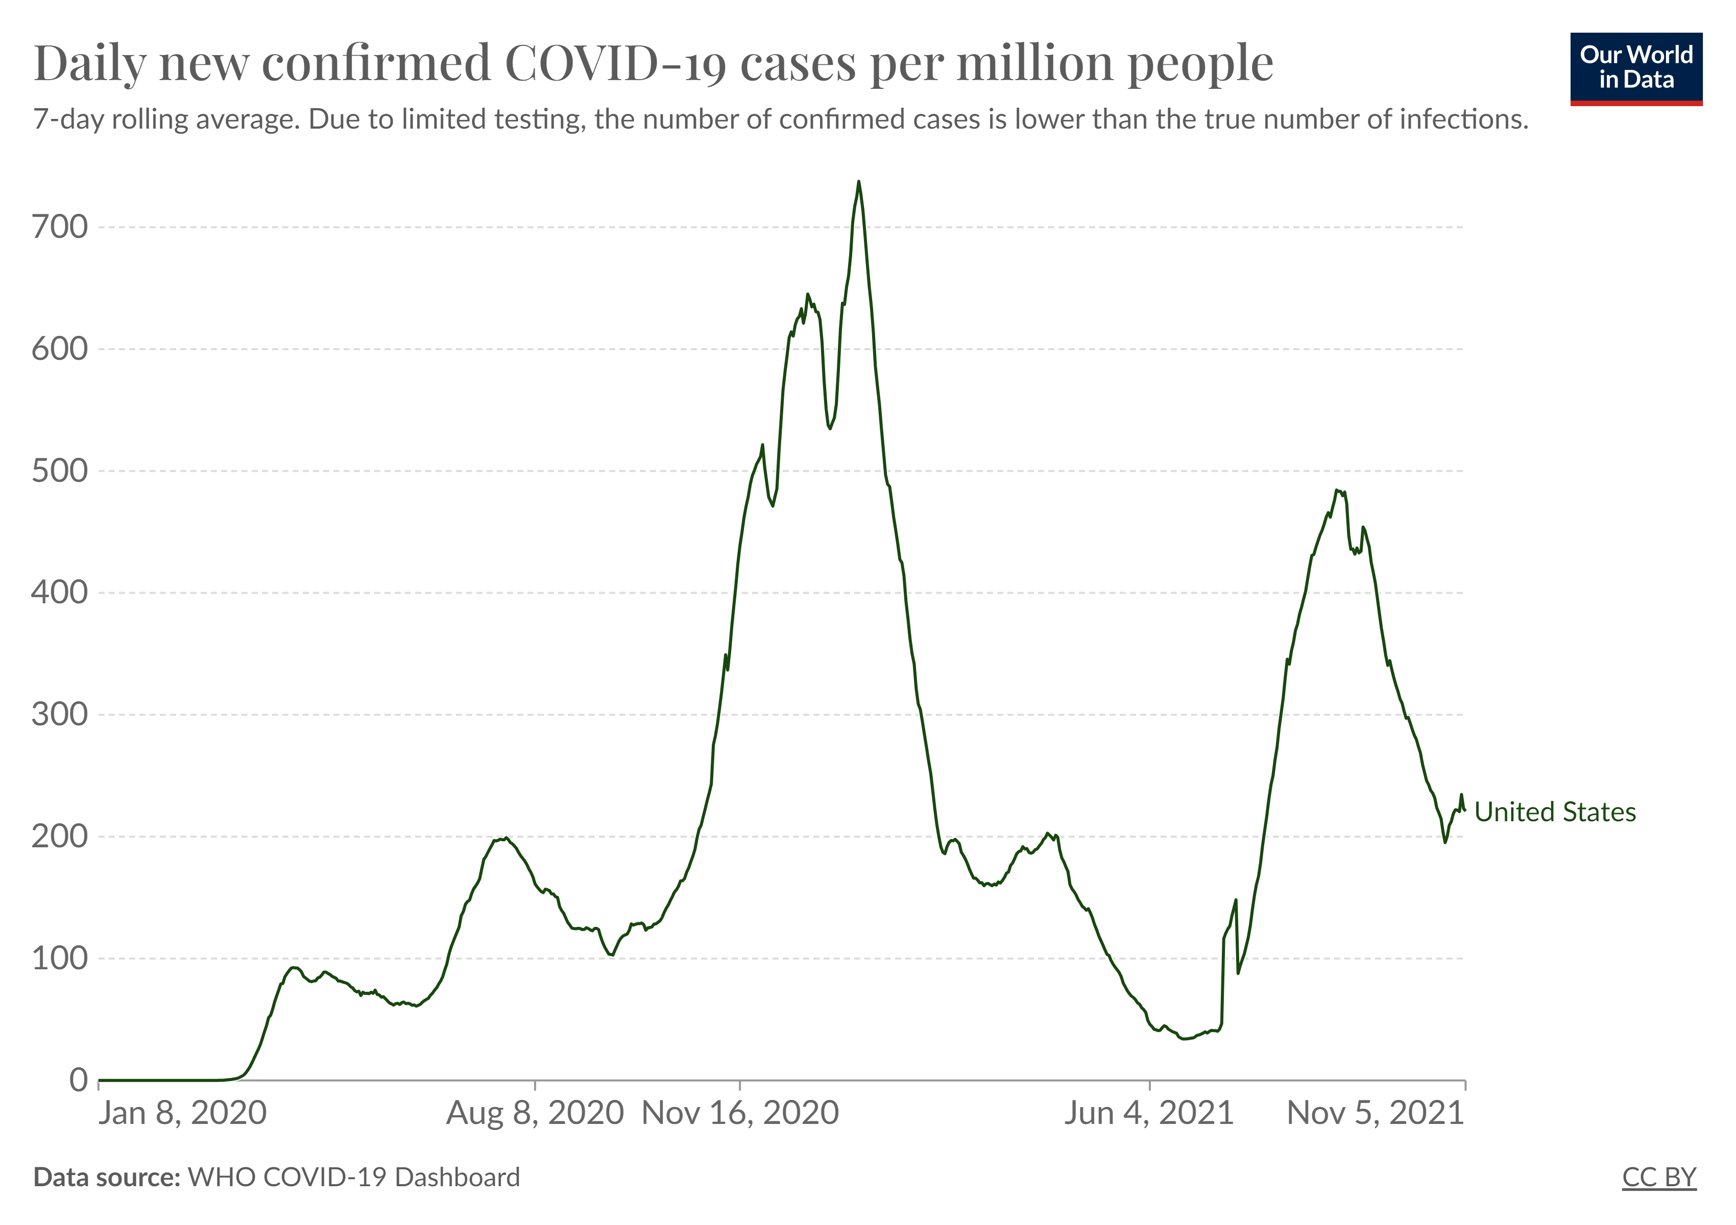


Slide 4
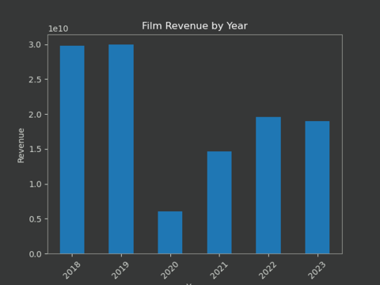

Slide 5
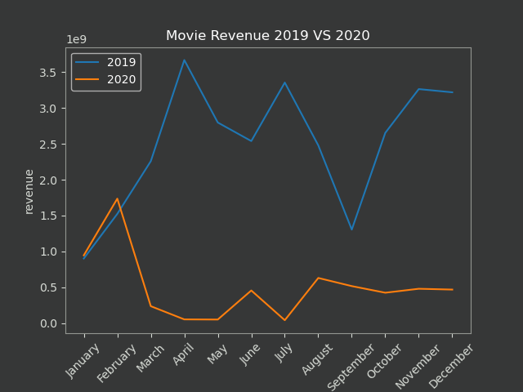

Slide 6
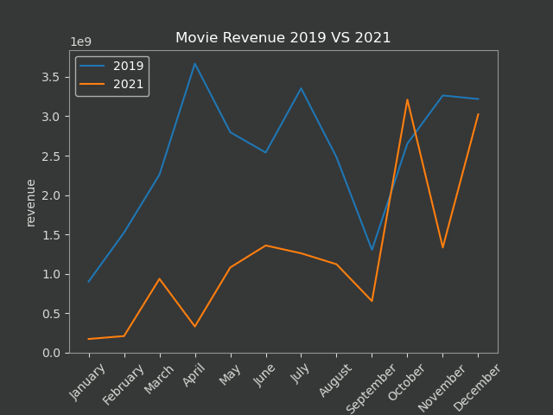

Slide 7
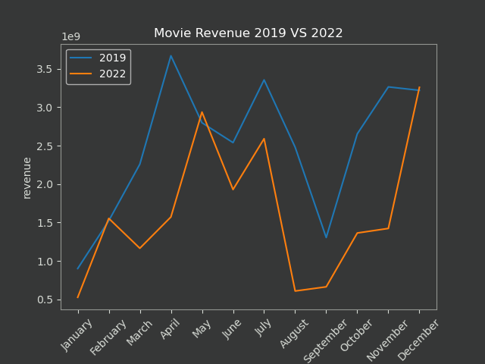

Slide 8
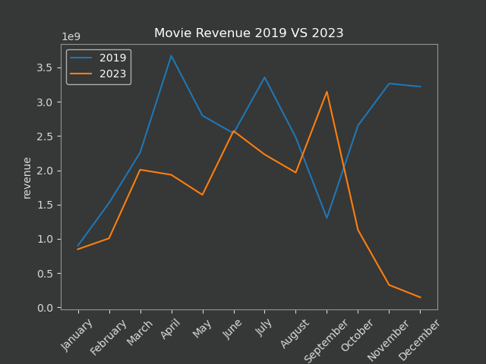

Slide 9
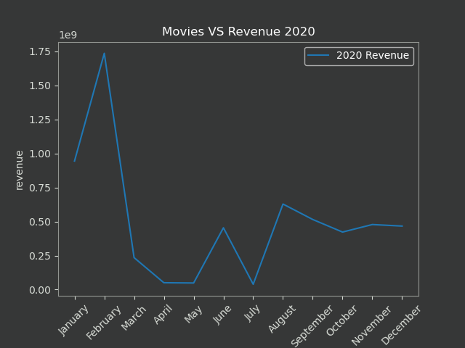

Slide 10
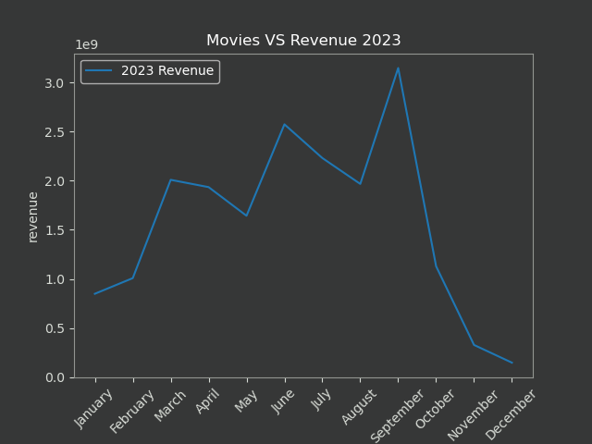

Slide 11
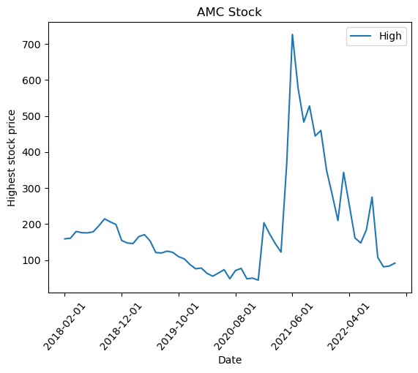

AMC Stock Prices 2018 to 2023

Slide 12
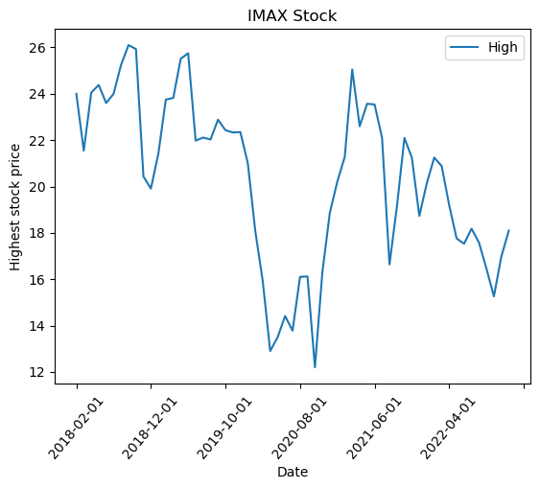

IMAX Stock Prices 2018 to 2023

Slide 13
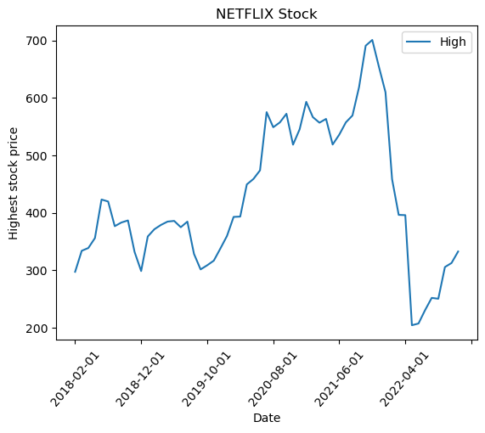

Netflix Stock Prices 2018 to 2023

Slide 14
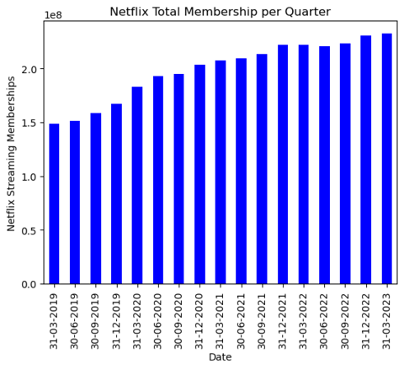

Netflix Memberships 2019 to 2023

Slide 15
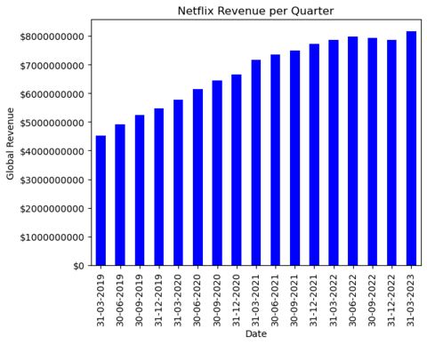

Netflix Revenue 2019 to 2023

Slide 16
Key takeaways
Revenue Losses during Pandemic
Streaming Service Explosion
Pandemic Numbers Rise, Movie Stock Prices Decline
Netflix Revenues Steadily Increase from 2019 to 2023
Revenues Continue to Underperform Pre-Pandemic Totals
The Movie Business is Cyclical

Slide 17
THANK YOU

